Slide 1
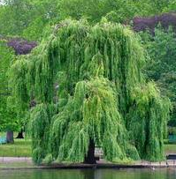


A Tensor-Based Algorithm for High-Order Graph Matching
Olivier Duchenne, Francis Bach,
Inso Kweon, Jean Ponce
École Normale Supérieure, INRIA, KAIST
Team Willow

Slide 2
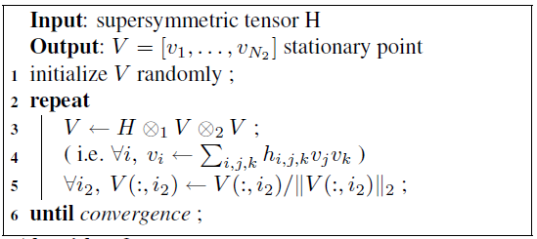
Contributions
Extension of [Leordeanu & Hebert] to the case of
hypergraph.
1) Tensor Formulation
and Power Method
2) Sparse output for
the relaxed matching
problem.

Slide 3
Previous Works
Generic Graph Matching Problem

Slide 4
Previous Works
Generic Graph Matching
NP-Hard combinatorial problem.
Wide and active literature existing on
approximation algorithms.
  Greedy
  Relaxed formulation
  Convex-concave optimization
  Many others…
[1] M. Zaslavskiy, F. Bach and J.-P. Vert. PAMI, 2009.
[2] D. C. Schmidt and L. E. Druffel. JACM, 1976.
[3] J. R. Ullmann. JACM, 1976.
[4] L. P. Cordella, P. Foggia, C. Sansone, and M. Vento. ICIAP, 1991.
[5] Shinji Umeyama. PAMI, 1988.
[6] S.Gold and A.Rangarajan. PAMI, 1996.
[7] Hong Fang Wang and Edwin R. Hancock. PR, 2005.
[8] Terry Caelli and Serhiy Kosinov. PAMI 2004.
[9] H.A. Almohamad and S.O.Duffuaa. PAMI, 1993.
[10] C.Schellewald and C.Schnor. LNCS, 2005.

Slide 5
Previous Works
Graph Matching
for Computer Vision (1)
[1] M. Fishler and Elschlager. Computer, 1973.
[2] Serge Belongie, Jitendra Malik and Jan Puzicha. NIPS 2000.

Slide 6
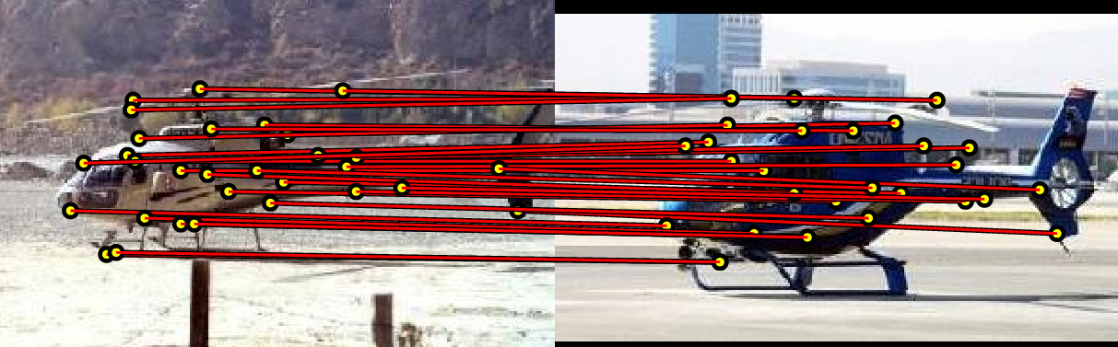
Previous Works
Graph Matching
for Computer Vision (2)
[1] A. C. Berg, T. L. Berg, and J. Malik. CVPR 2005
[2] M. Leordeanu and M. Hebert. ICCV 2005
[3] T. Cour and J. Shi. NIPS 2006.

Slide 7

Previous Works
Why we need correspondance?
Bag-Of-Word
model works well when relationship between features is not important.
?
=
Graph Matching is an attempt to compare
images when that relationship cannot be
ignored.
[1] Sivic & Zisserman. 2003
[2] Lazebnik et al. 2003
[3] Csurka et al. 2004

Slide 8
Previous Works
Objective function
(
)
.
.
.
m1
(
)
.
.
.
m2
First order score
Second order score
[1] A. C. Berg, T. L. Berg, and J. Malik. CVPR 2005.
[2] M. Leordeanu and M. Hebert. ICCV 2005.
[3] T. Cour and J. Shi. NIPS 2006.

Slide 9
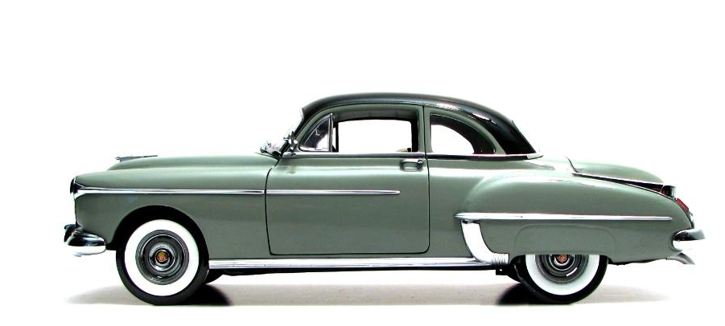
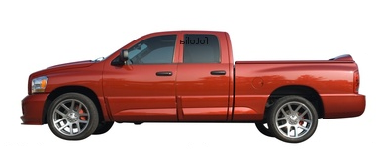
Hypergraph Matching Problem
How graph matching enforces
geometric consistency?
[1] A. C. Berg, T. L. Berg, and J. Malik. CVPR 2005.

Slide 10
Hypergraph Matching Problem
How graph matching enforces
geometric consistency?
[1] A. C. Berg, T. L. Berg, and J. Malik. CVPR 2005.
[2] M. Leordeanu and M. Hebert. ICCV 2005.

Slide 11
Hypergraph Matching Problem
How to improve it?

Slide 12
Hypergraph Matching Problem
How to improve it?

Slide 13
Hypergraph Matching Problem
Hypergraph Matching
A hyper-edge can link more than
2 nodes at the same time.
[1] Ron Zass and Amnon Shashua. CVPR, 2008

Slide 14

Hypergraph Matching Problem
Formulation

Slide 15
Hypergraph Matching Problem
Relaxation
Constraints:
Relaxed constraints:
Main
Eigenvector
Problem
Each node is matched to at most one node.
[1] M. Leordeanu and M. Hebert. ICCV 2005.

Slide 16
Hypergraph Matching Problem
Hypergraph Matching
H

Slide 17
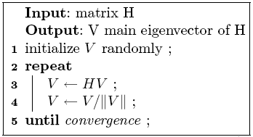
Hypergraph Matching Problem
Power Method
The power method can efficiently find the main
eigenvector of a matrix.
It can efficiently use the sparsity of the Matrix.
It is very simple to implement.

Slide 18
Hypergraph Matching Problem
Tensor Power Iteration
Converge to a local optimum (of the relaxed problem)
Always keep the full degree of the hypergraph (never marginalize it in a frist or second order)
[1] L. De Lathauwer, B. De Moor, and J. Vandewalle. SIAM J. Matrix Anal. Appl., 2000
[2] P. A. Regalia and E. Kofidis. ICASSP, 2000

Slide 19
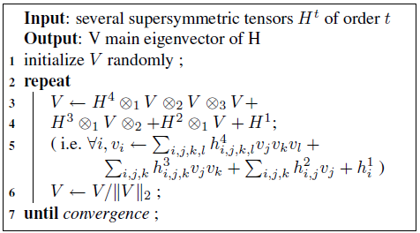
Hypergraph Matching Problem
Tensor Power Iteration
It is also possible to integrate cues of different orders.

Slide 20
Sparse Output
Sparse Output

Slide 21
Implementation
Compute all descriptor triplets of image 2.
Same for a subsample of triplets of image 1.
Use Approximate Nearest Neighbor to find the closest triplets.
Compute the sparse tensor.
Do Tensor Power Iteration.
Projection to binary solution.

Slide 22
Experiments
Artificial cloud of point.
We generate a cloud of random points.
Add some noise to the position of points.
Rotate it.

Slide 23
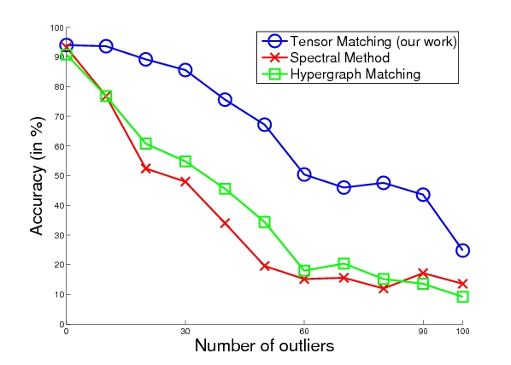
Experiments
Accuracy depending on outliers number
Our work
Leordeanu & Hebert
Zass & Shashua

Slide 24
Experiments
Accuracy depending on scaling
Our work
Leordeanu & Hebert
Zass & Shashua

Slide 25
Experiments
CMU hotel dataset
[1] CMU 'hotel' dataset: http://vasc.ri.cmu.edu/idb/html/motion/hotel/index.html

Slide 26
Experiments
Error on Hotel data set
Our work
Zass & Shashua
Leordeanu & Hebert

Slide 27
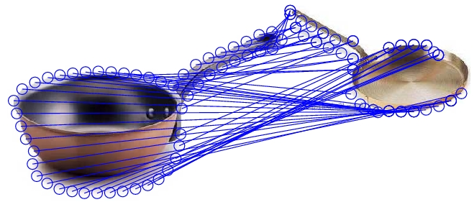
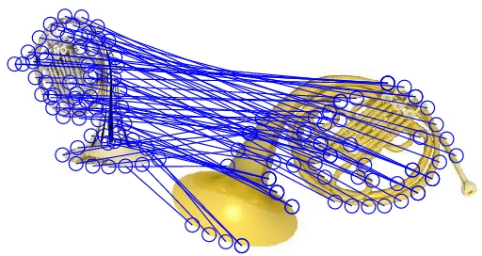
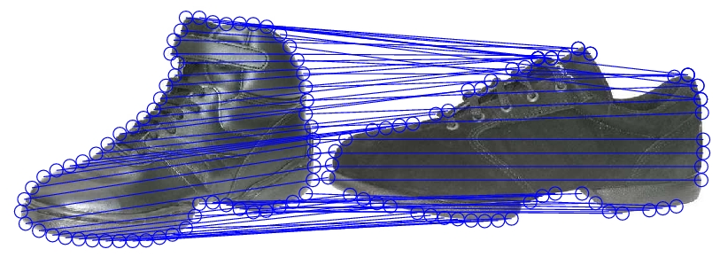
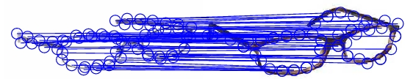
Experiments
Examples of Caltech 256
silouhettes matching

Slide 28
Conclusion
Method for Hyper-Graph matching.
Tensor formulation
Power Iteration
Sparse output
Future Work

Slide 29
Thank You !

