Slide 1

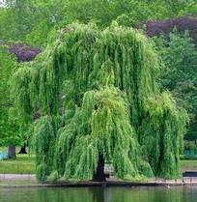

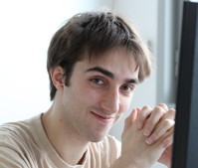
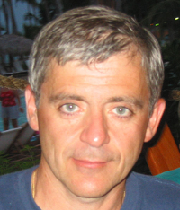
A Graph-Matching Kernel for Object Categorization
Willow
Lab
Olivier
Duchenne
Armand
Joulin
Jean
Ponce

Slide 2
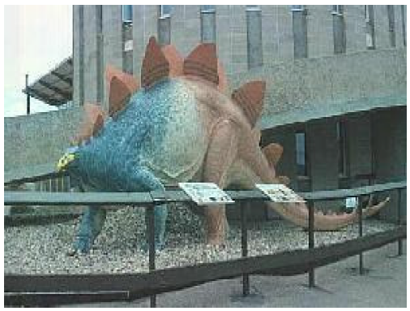
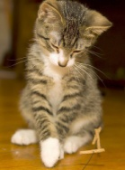
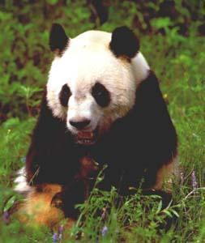
Goal: Object Categorization
DINOSAUR
CAT
PANDA

Slide 3
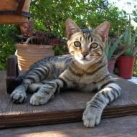
Comparing images
We need to design a good image similarity measure:
≈
?

Slide 4
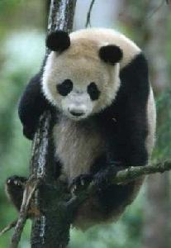
Unaligned Images are hard to compare

Slide 5
Unaligned Images are hard to compare

Slide 6
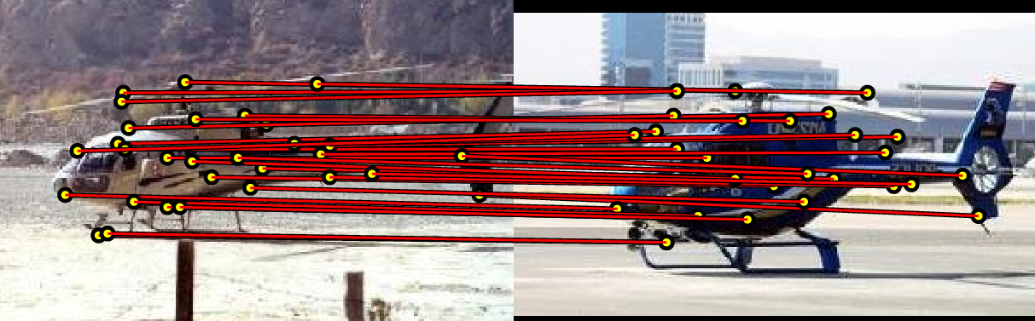
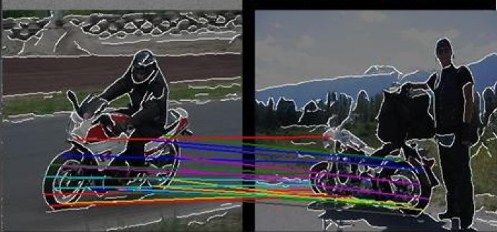
Graph Matching
[1] A. C. Berg, T. L. Berg, and J. Malik. CVPR05
[2] M. Leordeanu and M. Hebert. ICCV05

Slide 7
Feature Matching
Caputo (2004)
Boiman, Shechtman & Irani (2008)
Caputo & Jie (2009)

Slide 8
Graph Matching
Nevatia & Binford’72
Fischler & Elschlager’73
Berg, Berg, & Malik’05
Leordeanu & Hebert’05
Cour & Shi’08
Kim & Grauman’10
Etc.

Slide 9
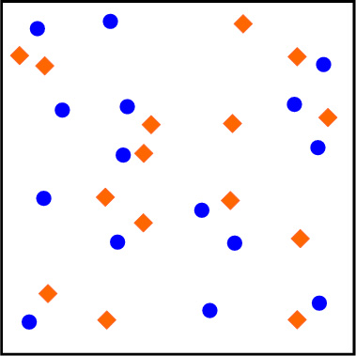
Spatial pyramid kernels
(Courtesy of L. Lazebnik)
Lazebnik, Schmid and Ponce (2006)
Indyk and Thaper (2003)
Grauman and Darrell (2005)

Slide 10
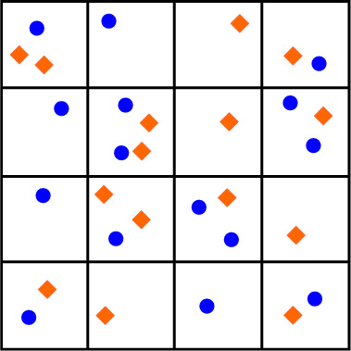

Slide 11
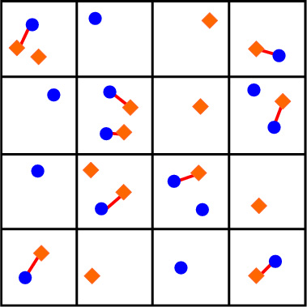
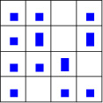
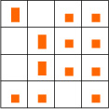
9 matches x 1
= 9

Slide 12
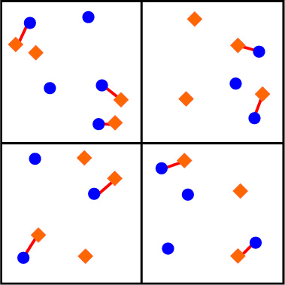
9 matches x 1
= 9

Slide 13
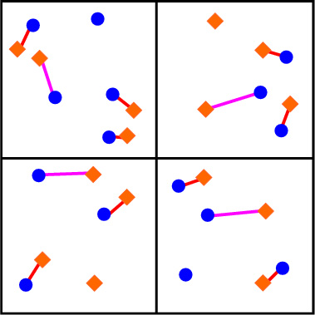
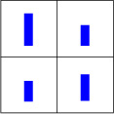
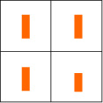
9 matches x 1
4 matches x ½
= 9
= 2

Slide 14
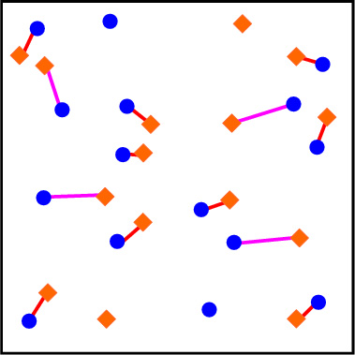
9 matches x 1
4 matches x ½
= 9
= 2

Slide 15
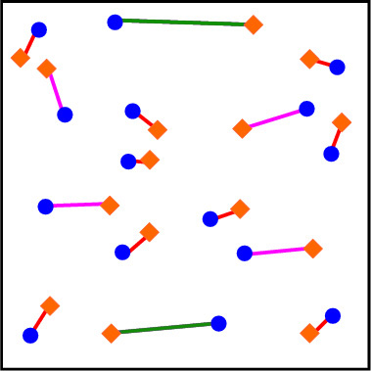


9 matches x 1
4 matches x ½
2 matches x ¼
= 9
= 2
= 1/2
Total matching weight (value of spatial pyramid kernel ): 9 + 2 + 0.5 = 11.5

Slide 16
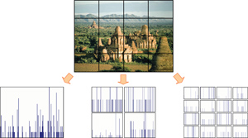

Graph Matching
Spatial Pyramids
VS
Approximate Feature Matching
Does not take into account pair-wise relationship
Require quantization
Low Computational Coast
Graph Matching
Take into account pair-wise relationship
Does not require quantization
High Computational Coast

Slide 17
So, how does it perform in real life?
Graph-Matching keeps more information, but is much slower…
In addition, it appears to perform much worse than SPM kernel.
Caltech 101 (%)
Graph Matching Based Methods | 15 examples
Berg Matching [CVPR 2005] | 48
GBVote [Berg phD thesis] | 52
Kim et Graumann [CVPR 2010] | 61
Spatial Pyramid Methods
Boureau et al. [CVPR10] | 69.0
Yang et al.[ICCV09] | 73.3

Slide 18
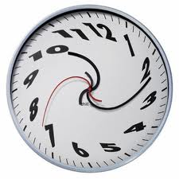
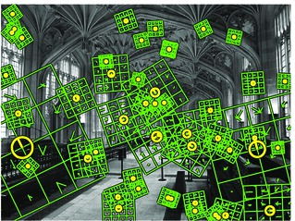
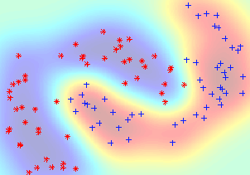
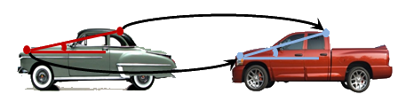
Graph Matching
Spatial Pyramids
VS
Dense Features
SVM classifier
Fast
No pair-wise
Information
State-of the-Art
performance
Sparse Features
NN Classifier
Slow
Use pair-wise
Information
Lower performance

Slide 19
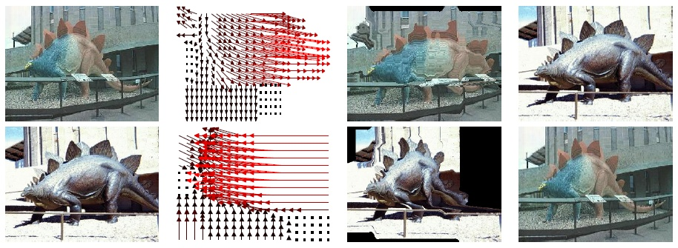
Our Approach
Spatial Pyramids
VS
Dense Features
SVM classifier
Fast
No pair-wise
Information
State-of the-Art
performance
As Dense
SVM Classifier
Fast enough
Use pair-wise
Information
State-of-the-art performance

Slide 20
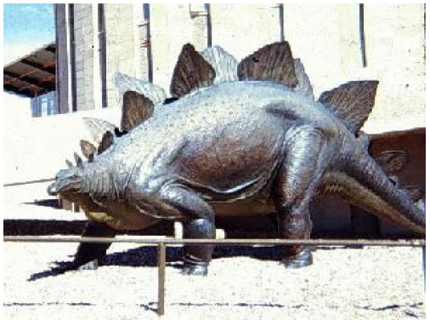
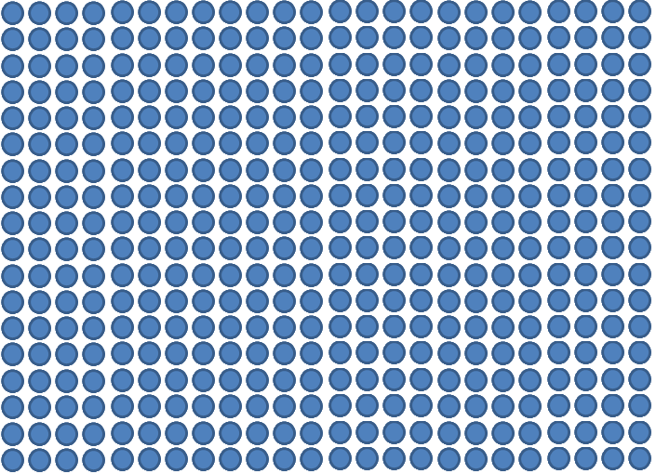
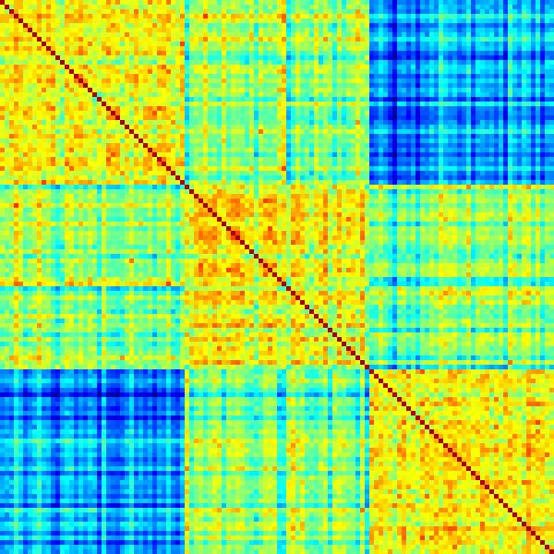
Outline of our method
Image j
Image i
K(Im_{i},Im_{j})
As Dense
SVM Classifier
Fast enough
Use pair-wise
Information
State-of-the-art performance
K=
Notes:
Our goal is to make a similarity measure based on graph matching, that we will be used as an SVM kernel
So we will compare each pair of training images.
So we need something very fast
Our kernel is not definite-positive, so we truncate the negative eigenvalues.
1vsAll SVM

Slide 21
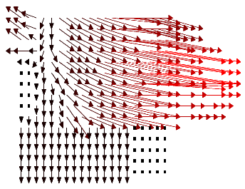
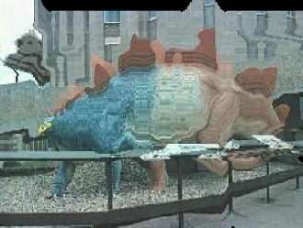
≈
?

Slide 22
Similarity
Sum of Local Similarities
≈
?
Deformation Smoothness
Maximized over all possible deformations

Slide 23
Graph-Matching on Dense Grid
Not too sparse (Graph matching…)
Not too dense (Medical image registration, sift flow, …)
We want the same level of density than SPM, HOG…
We use 18x24 grids

Slide 24
In our case: we allow each point to match to a 11x11 grid in the other image.
Notes:
For each node in the first image we want to assign a node in the second image.
Or equivalently, we will assign a displacement:
The displacement of the node in position (y,x) in the first image is denoted by:
d_{y}(y,x), d_{x}(y,x)

Slide 25
Unary term

Slide 26

Binary term
GOOD

Slide 27
Binary term
BAD

Slide 28
Binary term II
VERY BAD

Slide 29
Optimization problem
Minimize with respect to the integer disparity vector d:
This is (in general) an NP-hard problem…
…because there is no natural ordering on the vectors d
We give an efficient approximation algorithm

Slide 30
Vertical Move
The general problem is NP Hard, but if we just allow vertical moves, it can be solved optimally.

Slide 31
Horizontal Move
Horizontal moves can also be solved optimally.

Slide 32
Diagonal Move
Diagonal moves can also be solved optimally.

Slide 33
General Move
If all points move in the same direction (e.g. d_{x} increasing d_{y} decreasing), it can also be solved optimally.
The allowed moves can be different for each point, as long as they are in the same direction.

Slide 34
Optimization
Even if the whole optimization is NP hard, for each of the sub-problems (horizontal move,…) we can find the global optimum.
To optimize our objective function, we iterate over the different types of move, until convergence.
We can do it using Ishikawa’s method.

Slide 35
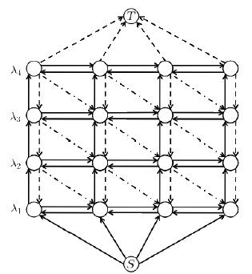


Optimization method
Ishikawa’s method can solve:
with
with g convex, and the labels mapped on integer.

Slide 36
Comparison with alpha-expansion
Alpha Expansion: At each iteration, each node can choose between keeping its label, or taking the label alpha.
Ours: At each iteration, each label can chose between K (=11) labels.
At convergence, the local minimum is better than its n neighbors:
Alpha Expansion:
Ours:
Total number of configurations:

Slide 37
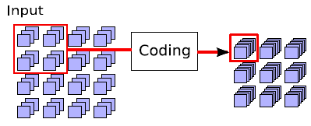
Summary
Extract Features
Global Normalization
Match pairs of images
Make a kernel from matching scores
Train 1vsAll SVM
Test with SVM

Slide 38

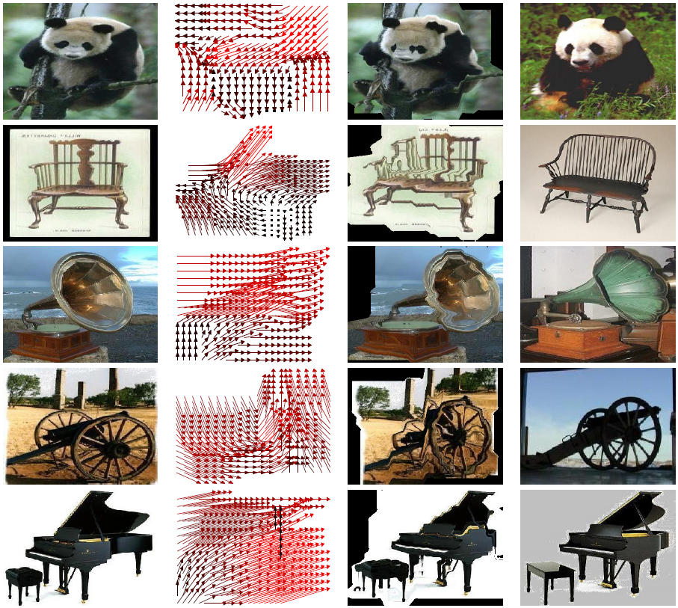

Slide 39
Results for Graph Matching methods
Caltech 101 (%)
Graph Matching Based Methods | 15 examples
Berg Matching [CVPR 2005] | 48
GBVote [Berg PhD thesis] | 52
Kim and Graumann [CVPR 2010] | 61
Ours | 75.3
+14%

Slide 40
Results: Caltech 101
Caltech 101 (%)
Feature | Method | 15 examples | 30 examples
Single | NBNN (1 Desc.) [CVPR08] | 65.0 | -
 | Boureau et al. [CVPR10] | 69.0 | 75.7
 | Ours | 75.3 | 80.3
+6%
+5%
Multiple | Gu et al.[CVPR09] | - | 77.5
 | Gehler et al.[ICCV09] | - | 77.7
 | NBNN (5 Desc.)[CVPR08] | 72.8 | -
 | Yang et al.[ICCV09] | 73.3 | 84.3
Notes:
Our implementation uses the same features than Boureau et al. [CVPR10], replacing spatial pyramids by our matching method.
We can see a clear improvement of performance (+6%).
This tends to show that geometric relationships between patches contains useful information.

Slide 41
Results: Caltech 256
Caltech 256 (%)
Feature | Method | 30 examples
Single | SPM+SVM[07] | 34.1
 | Kim et al. [CVPR10] | 36.3
 | NBNN (1 desc.) | 37.0
 | Ours | 38.1
Multiple | NBNN (5 Desc.)[CVPR08] | 42.0

Slide 42
Matching Time
Method | Number of Nodes | Time
Berg el al.[CVPR 05] | 50 | 5s
Leordaenu et al.[ICCV 05] | 130 | 9s
Kim , Grauman[CVPR10] | 4800 | 10s
Kim, Grauman[CVPR 10] | 500 | 1s
Alpha-Expansion | 500 | 1s
TRW-S | 500 | 10s
Ours | 500 | 0.04s
Notes:
Cost for matching 2 images

Slide 43
完
Conclusion
Graph-matching can make good performance
It is more interpretable, and it makes it easy to visualize what is happening.
Our main contributions are: the combination of SVM and graph matching; and the design of a fast matching algorithm.
Thank you
Questions?

